Slide 1
INTEGRATING EXCEPTION HANDLING AND DATA DEPENDENCY ANALYSIS THROUGH APPLICATION EXCEPTION RULES
Janani Ramachandran
Proposal Presentation
November 5th 2010
Committee Members:
Dr. Susan Urban (Chair)
Dr. Susan Mengel
*This research is supported by NSF Grant No. CCF-0820152.

Slide 2
Overview of Presentation
Motivation
Application Exception Rules Concept
Statement of Objectives
Related Work
Background
  Decentralized Data Dependency Analysis
  Assurance Points
Discussion of Research Plan
Summary

Slide 3
Motivation
Service-oriented computing (SOC) and Web services
  increasingly used for online business transactions.
  platform-independent and interoperable nature supports business-to-business (B2B) and business-to-consumer (B2C) applications.
Processes in SOC need relaxed isolation and more user-defined constraints to maintain correctness.
Relaxed form of isolation in SOC leads to inconsistencies and has been the focus of Decentralized Data Dependency Analysis (D3) Project.

Slide 4
Motivation
The Decentralized Process Execution Agents (PEXAs) model in (Liu 2009) proposed mechanisms to identify data dependencies among concurrently executing processes.
Support for user defined constraint checking and flexible failure recovery was proposed in the Assurance Points Model (Shrestha 2010).
Processes in concurrent execution environment need to handle interruptions due to external events, as well as identify and communicate any form of recovery to dependent processes.

Slide 5
Application Exception Rules Concept
An Application Exception Rule (AER) specifies recovery actions to be carried out on the occurrence of exceptions, based on process execution status.
AERs
  are triggered by the occurrence of external events.
  facilitate variable response to exceptions depending on status of execution.
  use AP checkpointing functionality to track execution status of process.
The proposed AER System will integrate exception handling and flexible recovery, with data dependency analysis to ensure consistency.

Slide 6
Statement of Objectives
Develop the concept of Application Exception Rules to support flexible exception handling and integrate their use with support for analysis of data dependencies for consistency in concurrent process execution.
Extend the AP model to support the specification of Application Exception Rules.
Integrate the use of data dependency analysis with the extended AP model.
Design and prototype an execution environment with data dependency analysis capability to demonstrate the AER concept.
Test and evaluate the AER model for concurrent process execution with a sample processing scenario.

Slide 7
Related Work
  Business Process Execution Language (BPEL) (Jordan et al., 2007)
    Process recovery involves Fault, Compensation and Termination handlers.
    Fault and Exception Handling capabilities that enable process recovery are inefficient, with the default compensation and fault orders being inconsistent and insufficient. (Khalaf, Roller, and Leymann 2009).
  Aspect-Oriented Programming (Kiczales et al., 1997) (Charfi and Mezini 2006)
    modularizes the process specification with respect to functionality that is not an actual part of the process flow.
    enables separation of concerns.
  Checkpoints, Events and Rules
    Checkpointing (Luo 2000) enables processes to roll back to the nearest consistent point and resume execution from that checkpoint.
    ECA rules (Liu et al., 2007) have been used to specify actions to carry out on occurrence of certain events that satisfy specific conditions.

Slide 8
Related Work
Techniques for Data Consistency in SOC
  Tentative Holding
  (Limthanmaphon & Zhang, 2004)
  Promises Approach
  (Jang, Fekete, and Greenfield 2007)
  Reservation-Based Protocol
  (Zhao, Moser, & Melliar-Smith, 2009)
  Transactional Attitudes
  (Mikalsen, Tai, & Rouvellou, March 2002)
The AER Concept allows processes to
  handle external events
  respond to exceptions based on execution status
  support variable recovery
  identify other processes affected by recovery
  communicate recovery to dependent processes

Slide 9
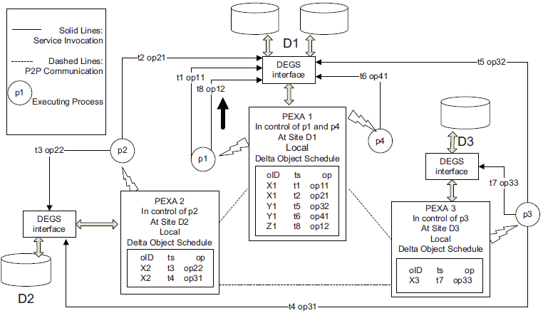
Background: Decentralized Data Dependency Analysis
Liu, Z. Decentralized Data Dependency Analysis for Concurrent Process Execution. M.S. Thesis, 2009.
Proposed decentralized approach to data dependency analysis using PEXAS.
Introduced the Lazy and Eager approaches to identify dependent processes.

Slide 10
Background: Assurance Points
Shrestha, R. Using Assurance Points and Integration Rules for Recovery in Service Composition. M.S. Thesis, 2010.
Proposed the use of Assurance Points (APs) as checkpoints at critical points in a process.
Introduced three flexible forms of recovery (APRollback, APRetry, APCC).

Slide 11
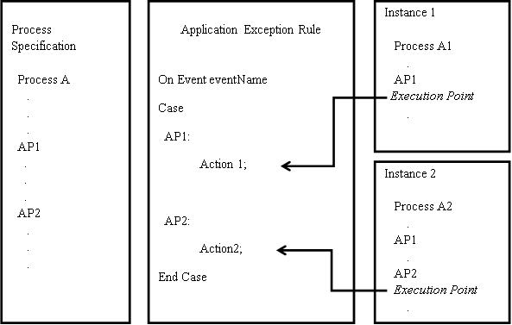
Application Exception Rules
Use of An Application Exception Rule

Slide 12
The AER System

Slide 13
Objective 1: AER Specification
Extend AP model to support specification and use of AERS.
development of the internal XML schema for the representation of AERs.
storage of runtime information about process execution status in a database for objects (db4o) object-oriented database.
Structure of an AER
On Event eventName
Case
AP1:
Action 1;
AP2:
Action2;
End Case

Slide 14
Objective 2: Integration of Data Dependency Analysis
In addition to exception handling, the AER system will
  perform data dependency analysis.
  interrupt execution of dependent processes.
Requires
  use of Delta Enable Grid Services (DEGS) (Urban et al., 2009) monitoring system.
  modification of approach in Decentralized PEXA model.
Two algorithms are proposed in PEXA model - Lazy and Eager.
Proposed system will use Lazy approach.

Slide 15
Objective 2: Integration of Data Dependency Analysis
Decentralized PEXA model assumes rollback as only form of recovery.
Data dependency is identified on a process-level.
AER system supports flexible recovery.
Requires data dependency analysis on recovered portion of process.
  Modify information stored in Delta Object Schedule.
  Modify querying of Delta Object Schedule.

Slide 16
Objective 3
Design and prototype an execution environment to demonstrate the AER concept. The prototype will
support concurrent process execution.
extend AP model to support AER specification.
include DEGS monitoring system to track deltas.
support event generation to interrupt process execution.

Slide 17
Objective 4
Test and evaluate the AER system in a concurrent process execution environment for
  generation of and response to external events by AERs.
  identification of and communication to dependent processes.

Slide 18
Summary
Capability to handle external events that affect process execution.
Mechanism to provide variable response to exceptions based on process execution status.
Support consistency along with flexible recovery and exception handling through integration with data dependency analysis.

Slide 19
References
Charfi, A. and Mezini, M. (2006). Aspect-Oriented Workflow Languages. Proceedings of Conference on Cooperative Information Systems (CoopIS 2006).
Jang, J., Fekete, A., and Greenfield, P. (2007). Delivering Promises for Web Service Applications. IEEE International Conference on Web Services (ICWS '07), 599-606.Jordan, D., Evdemon, J., Alves, A., Arkin, A., Askary, S., Barreto, C., et al. (2007). Web services Business Process Execution Language Version 2.0. OASIS Standard, 11.
Khalaf, R., Roller, D., and Leymann, F. (2009). Revisiting the behavior of Fault and Compensation Handlers in WS-BPEL. In Proceedings of the Confederated international Conferences, Coopis, Doa, Is, and ODBASE 2009 on the Move to Meaningful Internet Systems: Part I, 286-303.
Kiczales, G., Lamping, J., Mendhekar, A, et al. (1997). Aspect-Oriented Programming. Lecture Notes in Computer Science In Proceedings of the 11th European Conference on Object-Oriented Programming (ECOOP), Springer, 1242: 220-242.
Limthanmaphon, B., and Zhang, Y. (2004). Web service composition transaction management. In Proceedings of the 15th Australasian Database Conference (ADC 2004), Conference in Research and Practice in Information Technology, 27: 171-179.
Liu, Z. (2009). Decentralized Data Dependency Analysis for Concurrent Process Execution. M.S. Thesis, Texas Tech University.

Slide 20
References
Liu, A., Li, Q., Huang, L., and Xiao, M. (2007). A Declarative Approach to Enhancing the Reliability of BPEL Processes. Proceedings of the International Conference on Web Services, 272-279.
Luo, Z. W. (2000). Checkpointing for workflow recovery. In Proceedings of the 38th Annual on Southeast Regional Conference, 79-80.
Mikalsen, T., Tai, S., and Rouvellou, I. (2002). Transactional Attitudes: Reliable Composition of Autonomous Web Services. In Proceedings of the Workshop on Dependable Middleware-Based Systems (WDMS 2002), 44-53.
Shrestha, R. (2010). Using Assurance Points and Integration Rules for Recovery in Service Composition: M.S. Thesis, Texas Tech University.
Urban, S. D., Xiao, Y., Blake, L., and Dietrich, S. W. (2009). Monitoring Data Dependencies in Concurrent Process Execution through Delta-Enabled Grid Services. International Journal of Web and Grid Services, 5, 1: 85-106.
Zhao, W., Moser, L. E., and Melliar-Smith, P. M. (2005). A Reservation-Based Coordination Protocol for Web Services. In Proceedings of the IEEE International Conference on Web Services (ICWS’05), 49-56.

